Slide 1
Periodic Trends

Slide 2
Lesson Objectives
State that the Periodic Table is arranged in order of increasing atomic number.
Relate the arrangement of elements in the Periodic Table to their electron configuration.
State that the main groups of the Periodic Table represent elements with similar chemical properties and the same number of valence electrons.
State that the periods of the Periodic Table represent the number of occupied electron shells.
Locate the position of an element in the Periodic Table from its electron configuration.
Given the position on the Periodic Table of a main group element, predict chemical properties.
State the common names for Groups 1, 2, 17 and 18.
Write symbolic representations of elements and monatomic ions showing A, Z and charge.
State that the electrons in an atom are located in energy levels or shells.
Write the electron configuration of the first twenty elements and their monatomic ions (shell only).
Explain how positive ions and negative ions are formed by the donation and acceptance of valence electrons.

Slide 3
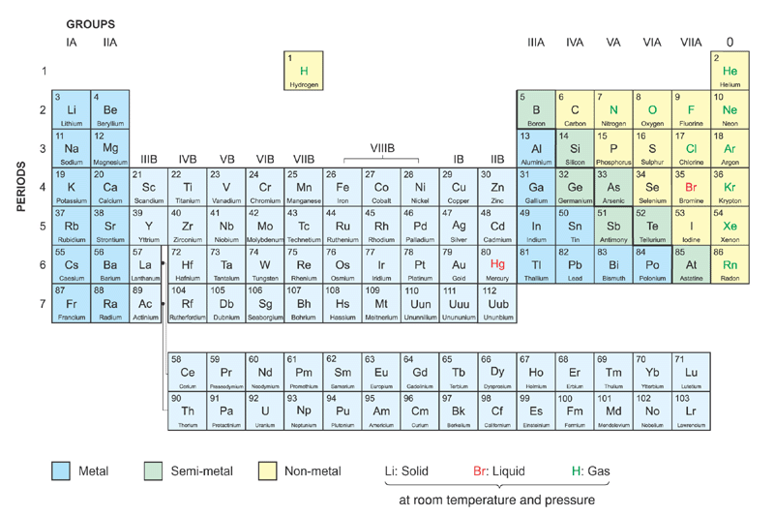
Elements are arranged in the increasing order of atomic number
The modern Periodic Table

Slide 4
Group names:
The Noble Gases
Alkali Metals
Alkaline Earth Metals
The Halogens
Transition Metals
The modern Periodic Table

Slide 5
Horizontal rows → periods → same no. of occupied shells
7 periods
The modern Periodic Table

Slide 6
Vertical columns → groups
→ same no. of outermost shell electrons
18 groups
The modern Periodic Table

Slide 7
Periodicity : Properties of elements are periodic functions of atomic number
The modern Periodic Table

Slide 8
Periodicity : Similar properties of elements recur periodically
The modern Periodic Table

Slide 9
Periodicity : Properties of elements vary periodically with atomic number
The modern Periodic Table

Slide 10
Lesson Objectives
State that the Periodic Table is arranged in order of increasing atomic number.
Relate the arrangement of elements in the Periodic Table to their electron configuration.
State that the main groups of the Periodic Table represent elements with similar chemical properties and the same number of valence electrons.
State that the periods of the Periodic Table represent the number of occupied electron shells.
Locate the position of an element in the Periodic Table from its electron configuration.
Given the position on the Periodic Table of a main group element, predict chemical properties.
State the common names for Groups 1, 2, 17 and 18.
Write symbolic representations of elements and monatomic ions showing A, Z and charge.
State that the electrons in an atom are located in energy levels or shells.
Write the electron configuration of the first twenty elements and their monatomic ions (shell only).
Explain how positive ions and negative ions are formed by the donation and acceptance of valence electrons.

Slide 11
Question Time
Locate the period and group from the electron figuration only…
2,8,8,1 - Element =
2,0 - Element =
2,8,6 - Element =
2,7 - Element =

Slide 12
Lesson Objectives
State that the Periodic Table is arranged in order of increasing atomic number.
Relate the arrangement of elements in the Periodic Table to their electron configuration.
State that the main groups of the Periodic Table represent elements with similar chemical properties and the same number of valence electrons.
State that the periods of the Periodic Table represent the number of occupied electron shells.
Locate the position of an element in the Periodic Table from its electron configuration.
Given the position on the Periodic Table of a main group element, predict chemical properties.
State the common names for Groups 1, 2, 17 and 18.
Write symbolic representations of elements and monatomic ions showing A, Z and charge.
State that the electrons in an atom are located in energy levels or shells.
Write the electron configuration of the first twenty elements and their monatomic ions (shell only).
Explain how positive ions and negative ions are formed by the donation and acceptance of valence electrons.

Slide 13
Electron Arrangement Recap
Complete the following worksheet.
It will highlight the terms:
Energy Level
Isoelectronic
Species
Make sure you define them before you finish.

Slide 14
Lesson Objectives
State that the Periodic Table is arranged in order of increasing atomic number.
Relate the arrangement of elements in the Periodic Table to their electron configuration.
State that the main groups of the Periodic Table represent elements with similar chemical properties and the same number of valence electrons.
State that the periods of the Periodic Table represent the number of occupied electron shells.
Locate the position of an element in the Periodic Table from its electron configuration.
Given the position on the Periodic Table of a main group element, predict chemical properties. (each group has the same outer number of electrons and so similar properties)
State the common names for Groups 1, 2, 17 and 18.
Write symbolic representations of elements and monatomic ions showing A, Z and charge.
State that the electrons in an atom are located in energy levels or shells.
Write the electron configuration of the first twenty elements and their monatomic ions (shell only).
Explain how positive ions and negative ions are formed by the donation and acceptance of valence electrons.

